Slide 1

THEATRE NORTHWEST
Team Sparklers
CLIENT: 1. Dr. Patrick Immel
2. Ms. Wendy Eloe
TEAM MEMBERS:
Supraja Kumbam
Keerthi Chiduruppa
Saivarun Illendula
Rahul Reddy Lankala
Ashwith Gundu
Santhosh Bonala

Slide 2

Outline
Problem Statement
Proposed Solution
Project Requirements
Tools and Technologies
Demonstration
Future Tasks to be accomplished
Supraja Kumbam

Slide 3




Theatre appreciation students
Problem Statement
Google Forms
Theatre
Regular audience
Supraja Kumbam

Slide 4




Problem Statement (Cont’d)
Excel File
Mails
+
Google Forms
Supraja Kumbam
Documents

Slide 5



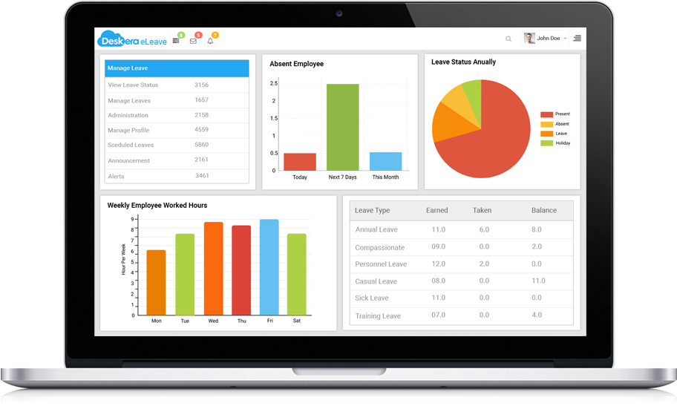
Proposed Solution
Automatic Emails
Customized Reports
Dashboard
Web Application
Supraja Kumbam

Slide 6

Project Requirements
S. No. | Requirements | Admin
1. | Login Feature
2. | Add New Show Functionality
3. | Publishing and Unpublishing a Show
4. | Modify Existing Show Information
5. | Admin will be able to Add Another Admin
Keerthi Chiduruppa
Notes:
During the client meeting, the client has discussed some key requirements and their accessibility to the audience and the admin.

Slide 7
Project Requirements (Cont’d)
S. No. | Requirements | Admin
6. | Delete Show Functionality
7. | Report Generation Functionality
8. | Duplicate a show
9. | Define the ticket type and price
10. | Create a show with multiple dates
Keerthi Chiduruppa

Slide 8
Project Requirements (Cont’d)
S. No. | Requirements | Audience | Admin
11. | Reserve Tickets For Multiple Shows
12. | Search Functionality
13. | Directions towards show venue |  | -
14. | Confirmation Email |  | -
15. | Reminder Email |  | -
Keerthi Chiduruppa

Slide 9
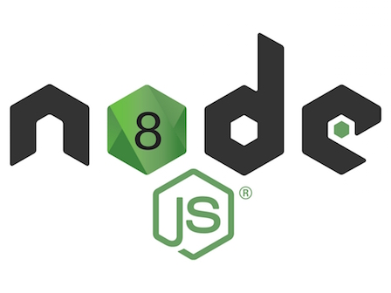




Technologies
(Backend/Server)
API Calls
Deploy
Response for API Calls
+
DB Response
DB Request
(Frontend)
(Database)
Keerthi Chiduruppa
Notes:
Vue.js – It is an open source JavaScript framework for building interactive user interfaces. The main advantage of using Vue.js for the frontend development is that it is very simple to use and understand (as it is a mix of HTML, CSS and JavaScript languages) and it can be easily integrated into any existing application. (As Vue.js is a JavaScript framework it can be easily integrated into any application built using the JavaScript).
Bootstrap – Open source front end framework It contains html and CSS based templates.
https://vuejs.org/v2/guide/comparison.html
(Please refer to the link to find out what makes Vue.js a little better than Angular)
Nodejs - Node.js is a server-side platform built on Google Chrome's JavaScript Engine (V8 Engine). Node.js is an open source platform for developing server-side and networking applications. Node.js applications are written in JavaScript, and can be run within the Node.js.
running scripts server-side to produce dynamic web page content before the page is sent to the user's web browser.
Advantages:
1. Very Fast as it is built on Google Chrome's JavaScript Engine (V8 Engine).
2. Asynchronous and Event Driven means a Node.js based server never waits for an API to return data. The server moves to the next API after calling it and a notification mechanism helps the server to get a response from the previous API call.
MongoDB - MongoDB is a popular No-SQL database. It stores data in flexible, JSON-like documents making data easy to work with and analyze. MongoDB is free and open-source database and it is distributed in nature which means that data is located locally where it is mostly used, then the communication costs for data manipulation can be minimized. The advantage of having a distributed database is that even if there is a single point of failure, the system performance is not affected.

Slide 10





Tools
Postman
Visual Studio Code
TortoiseGit
GitHub
MongoDB Compass
Saivarun Illendula
Notes:
GitHub - GitHub Inc. is a web-based hosting service. It is mostly used for storing, sharing and retrieving computer code. GitHub offers plans for both private repositories and free accounts. In our project we have created a private repository (using a student account) and added all the team members along with Hemanth. We have created a developer branch for our repository so that all the commits are made to the developer instead of the main branch to avoid any conflicts.
Postman - Postman is a powerful HTTP client for testing web services. Postman makes it easy to test, develop and document APIs by allowing users to quickly put together both simple and complex HTTP requests.
MongoDB Compass – MongoDB Compass is a GUI which displays the information about the MongoDB database and can also be used to perform queries.
Visual Studio Code - Visual Studio Code is a source code editor. It supports a number of programming languages and a set of features that may or may not be available for a given language.
TortoiseGit - TortoiseGit is a Git revision control client, implemented as a Windows shell extension (free software). Besides showing context menu items for Git commands, TortoiseGit provides the status of Git working trees and files. It also comes with the TortoiseGitMerge utility to visually compare two files and resolve conflicts.

Slide 11



Testing Tools
11
Saivarun Illendula
Notes:
Chai is a assertion library. Can be used on both the node and the browser. It can be paired with any JavaScript testing framework in use today.
Mocha is a feature-rich JavaScript test framework running on Node.js and in the browser, making asynchronous testing simple and fun. Mocha tests run serially, allowing for flexible and accurate reporting, while mapping uncaught exceptions to the correct test cases. Hosted on Github.
Chai and Mocha are commonly used together for unit testing. Unit testing means testing the behavior of code in small, independent units. Units are typically designed to be the smallest meaningful chunk of independently testable code
Karma is a testing tool for JavaScript that runs on Node.js and in the browser. Using Karma to run tests using one of many popular JavaScript testing suites (Jasmine, Mocha, QUnit, etc.) and have those tests executed not only in the browsers of your choice, but also on the platform of your choice (desktop, phone, tablet.)
The main goal for Karma is to bring a productive testing environment to developers. This environment is where the users don't have to set up loads of configurations, but rather a place where developers can just write the code and get instant feedback from their tests.

Slide 12


Integration of Testing Tools
Vue.js
Vue Utils
Mocha Awesome
BACK-END
FRONT-END
12
Saivarun Illendula
Notes:
Mocha Awesome: Mocha awesome is a custom reporter tool that can be used with the Javascript testing framework, mocha.
Vue Utils: VueTestUtils is the official unit testing utility library for Vue.js. It can be used for frontend testing.

Slide 13

Tasks Completed before Mid-Term (GDP II)
Admin
Edit Show Feature
Reserve Tickets Feature
Duplicate Show Feature
Multiple Dates for a Show
Custom Ticket Criteria Feature
Announcement Email Feature
Publish and Unpublish a show
Search Functionality
Edit and Delete Admin Feature
Audience
Dashboard
Cancel Ticket
Directions
Search Functionality
Saivarun Illendula

Slide 14
Tasks Completed After Mid-Term (GDP II)
Audience
Show reservation
Showing location
Admin
Reminder Emails to Audience
Show reservation
Report Generation
Cancel (Unreserve) Ticket Feature
Confirmation Emails to Audience
Audience Dashboard preview
Deployment
AWS
Saivarun Illendula
14

Slide 15

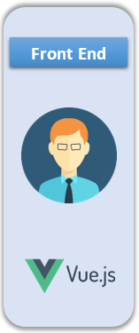
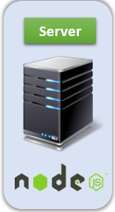
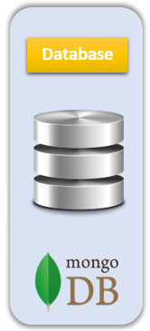
Token Generation
6. Generate token
2. User exists or not
1. Login Request
3. User exists
4. Password match
8. Send the token
5. Valid Password
7. Store the token
Santhosh Bonala

Slide 16
Token Utilization & Hashing
2. Verify Token
1.Add New Admin (TOKEN)
4. Save the Hash
5. Send response
6. Send response
3. Validate Password & Hash
Santhosh Bonala

Slide 17

Ashwith Gundu
Rahul Reddy Lankala
Santhosh Bonala

Slide 18
Problems Faced
Generating a Map for the User
Duplicating a show
Handling Images for a show
Testing Environment for the application
NodeJS Version Issues
Santhosh Bonala

Slide 19
Lessons Learnt
Used a Map Component
Using Different Primary Key for each show
Handling Images on Backend instead of Database
Always use different environments for testing and development
By Updating NodeJS to latest non breakable version
Santhosh Bonala

Slide 20
Lessons Learnt
Team Management | We collaborated with each other while working on the project
Time Management | We were able to implement the major functionalities of the project on time because of utilizing the time effectively
Resource Management | We divided the tasks based on each and individual skill set
Communication Management | We communicated effectively via Google Docs and other communication media
Quality Management | Till the end we all tried our level best in bringing the product as per the requirements of our client
Santhosh Bonala

Slide 21

Future tasks yet to be accomplished
Create User and Developer manual
Frontend and Backend Testing
Santhosh Bonala
Notes:
Reminder Emails : These are emails which are preset with subject and body, they are sent to the audience one day before their show time.
User Show reservation : We need to develop a model for the user where he/she can reserve ticket
Report generation : A excel report will be generated for the admin with consisting of various sheets like audice of a particular show, only theatere appreciation students
Cancel : Admin shall be
Confirmation emails: It is sent to the audience once he/she reserves a ticket
Deployment: we need to deploy the application on platforms like heroku
Finally we

Slide 22
Acknowledgement
We wish to express our sincere gratitude to Dr. Bandi for mentoring and guiding us while developing the THEATRE NORTHWEST project.
We sincerely thank our clients Dr. Patrick Immel & Ms. Wendy Eloe for giving us an appointment every week in spite of busy schedule which made us to gather the requirements at each and every phase while developing our project.
We also thank Socio Analyzer & Disaster Response and Reporting System teams for giving us a competitive environment for working on our project
Ashwith Gundu

Slide 23
THANK YOU

Slide 24
Tasks Completed in GDP I
Gathered Requirements
Developed Prototypes
Setting up Front-end (VueJs) Environment
Setting up Back-end (NodeJs)
Environment
Token Based Authentication for Admin Login
Developed Database Design
Admin
Login Feature
Add New Show Feature
Add New Admin Feature
Delete Show Feature
Generating Sample Reports
Adding New Section Feature

